Slide 1
How does matter change?
Matter can undergo physical and chemical changes.
Physical Changes show changes in size, shape, color or state
Chemical Changes show changes in the form of a new substance.

Slide 2
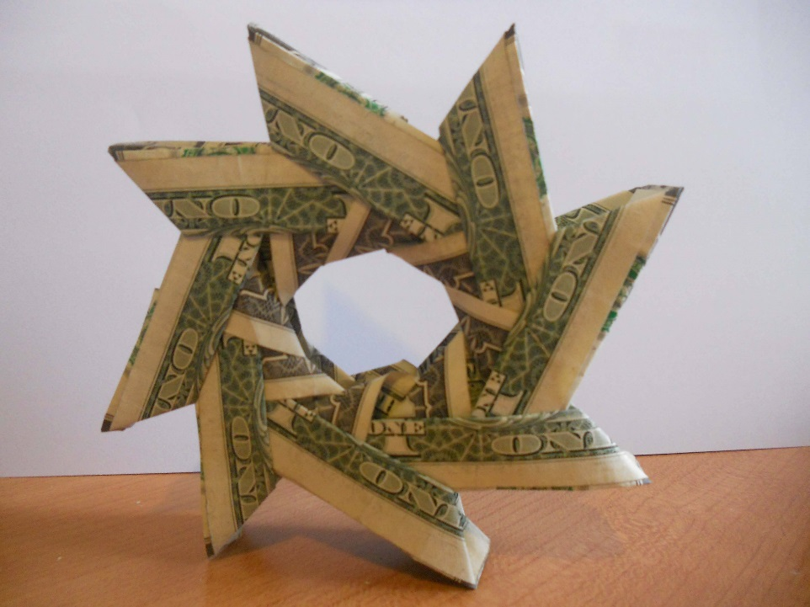
Physical Change
Physical Changes are changes in
size, shape, or state.
The particles in the material do not change, but can move.

Slide 3
Chemical Changes
A Chemical Change creates a new type of matter.
Particles of one substance are changed to form a new substance.
Chemical Changes can be observed when there are bubbles, heat, change in smell, or change in color.

Slide 4
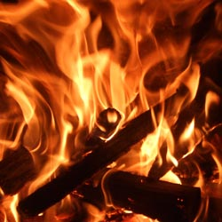
Chemical Changes
Burning wood is an example of a chemical change.
When wood is burned it results in ash, carbon dioxide gas, and water vapor.
http://www.youtube.com/watch?v=VnbTQupMjO8

Slide 5
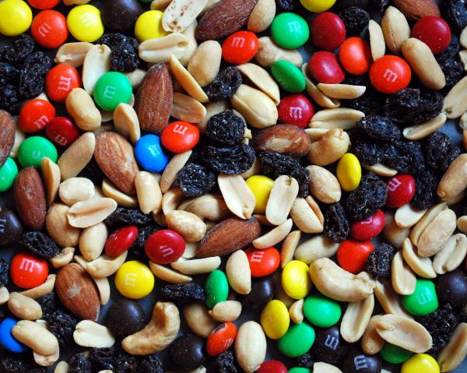
Mixtures
Mixtures are an example of physical changes because the items are easily separated.
Trail-mix would be an example of a mixture.

Slide 6
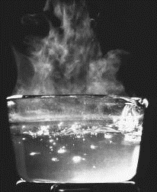
Phase Change
States (Gas, Solid, Liquid) are also called Phases.
Objects change phase when energy (heat) is added or removed.

Slide 7
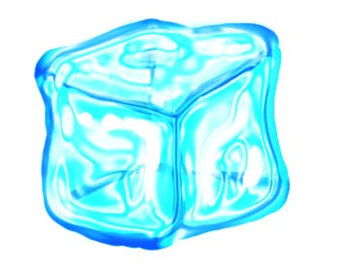
Phase Change
The Melting Point is the temperature in which a solid turns into a liquid
The Freezing Point is the temperature in which a liquid turns into a solid.

Slide 8
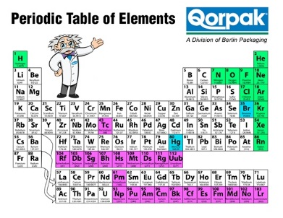
Elements
Elements are the
materials that make
up all living and
nonliving things.

